Slide 1
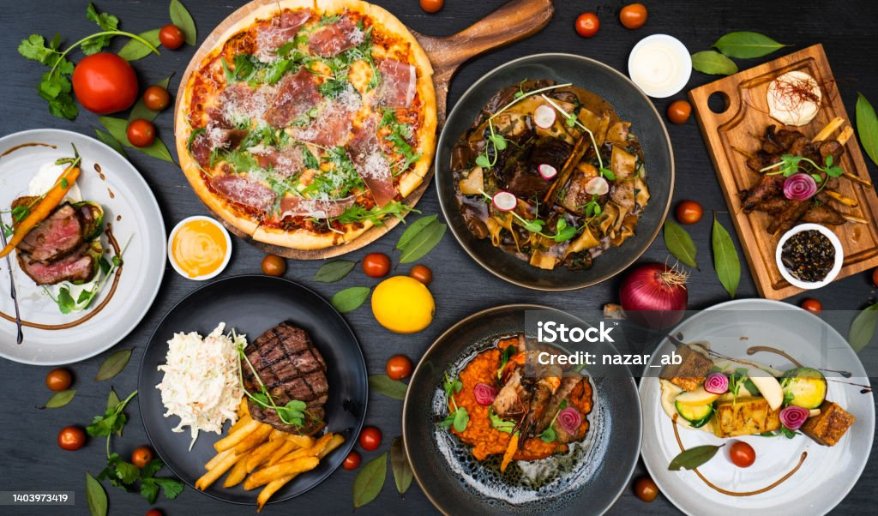

Food Service Company
Name: Md Masum
Batch:51 (Roll: 01-051-25)
Department of Political Science
Date 14.12.2024

Slide 2

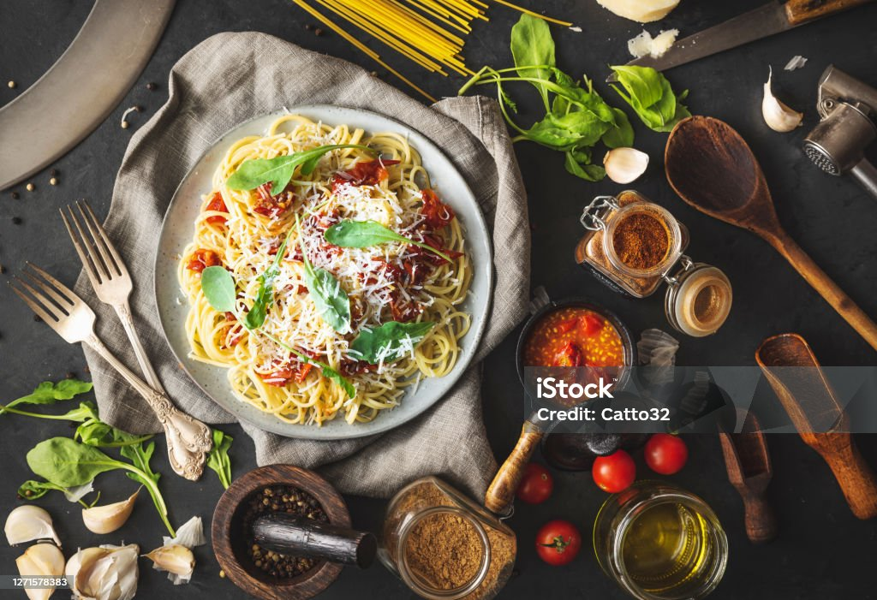

Brief introduction to the company
A food service company is a business that prepares and serves food to consumers. This can take many forms, including:
Restaurants: Sit-down establishments with a variety of foods on the menu.
Fast food: Chains that offer pre-made meals quickly and at a lower cost.
Cafes: Casual spots serving coffee, tea, pastries, and light fare.
Caterers: Businesses that prepare and deliver food for events.
Food distributors: Companies that supply food and ingredients to restaurants and other businesses.
Food service companies play a major role in our daily lives, providing meals for people on the go, at work, at school, and during special occasions.

Slide 3
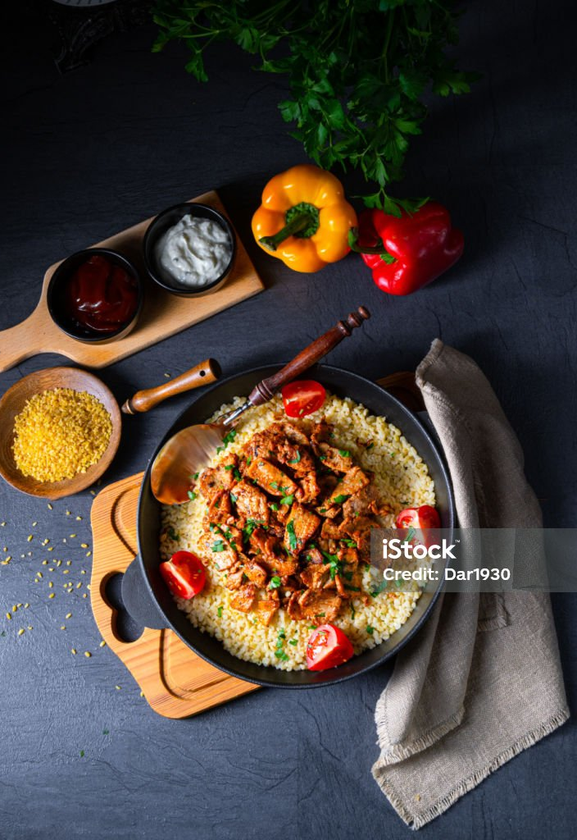

Key products and services
Food service companies offer a wide range of products and services to businesses in the food and beverage industry. These can be broadly categorized into two main areas:
1. Food and Beverage Products:
Fresh and frozen food: This includes a wide variety of meats, poultry, seafood, produce, dairy products, and bakery items.
Dry goods and pantry staples: This includes items such as flour, sugar, rice, pasta, beans, canned goods, and condiments.
Beverages: This includes soft drinks, juices, coffee, tea, alcoholic beverages, and more.
2. Food Service Equipment and Supplies:
Kitchen equipment: This includes ovens, refrigerators, freezers, dishwashers, mixers, food processors, and other equipment used in food preparation.
Restaurant supplies: This includes disposable cups, plates, napkins, utensils, tablecloths, and other items used in food service.
Janitorial supplies: This includes cleaning products, paper towels, garbage bags, and other items used to keep a restaurant clean.

Slide 4

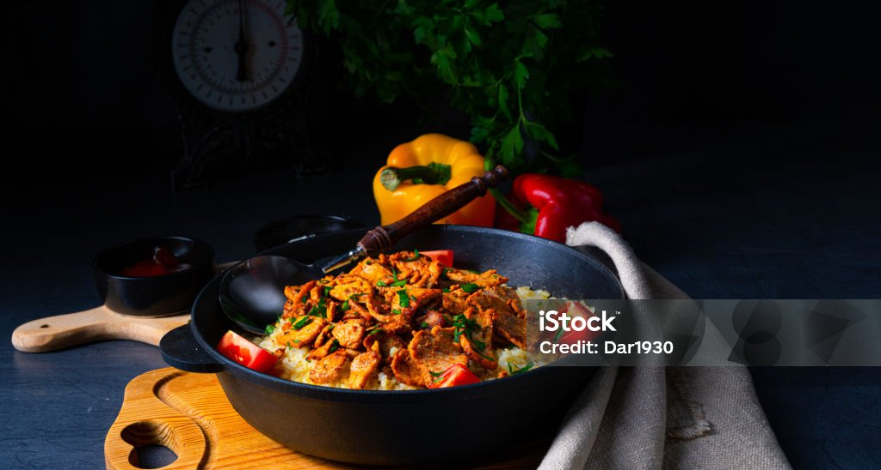
Analyze the company’s statistical data

Slide 5
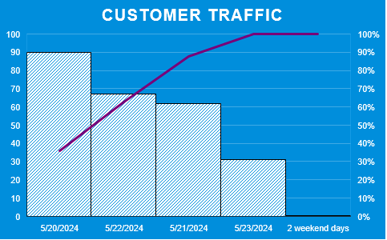
COMPARISON
Comparison between Customer Traffic and Total Sales

Slide 6
Selling Rate
Everyone from children to adults likes our food, but children like it more.
30%
25%
20%
Dessert
Chicken chop
Vegetables
10%
10%
5%
Fish
Meat
Egg

Slide 7
Price Chart
 | Single | Double | Special
Desert | 50,000 | 400,000 | 1,600,000
Frozen Fish | 500,000 | 4,000,000 | 16,000,000
Chicken palate | 75 | 80 | 90
Meat | 5,625,000 | 48,000,000 | 216,000,000
Beaf | 0 | 0 | 0
Vegetables | 5,625,000 | 48,000,000 | 216,000,000
Chicken chop | 1,687,500 | 9,600,000 | 21,600,000
Egg fry | 562,500 | 2,400,000 | 10,800,000
Pasta | 281,250 | 2,400,000 | 4,320,000
Nodose | 7,593,750 | 52,800,000 | 187,920,000
Enjoy high-quality food at a low cost.

Slide 8
BIG IMAGE

Slide 9
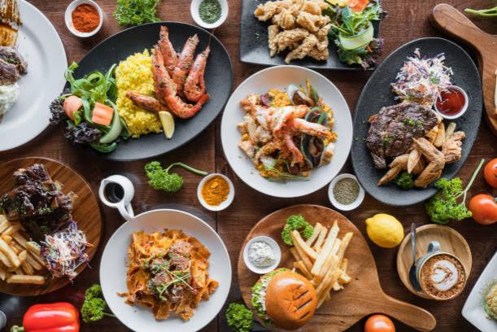
The smell of our food will make you intoxicated.
Notes:
Welcome to our Company

Slide 10

THANK YOU!
Food Service Company
Phone:
01722387826
Email:
masum5219@gmail.com
Food service company

Slide 11
Address to visit our company
Barishal university Road
63 No Streets
Cell: 043111178
Food service company

